Slide 1
ANALYSIS OF 2021 STATE OF cs success, Optimization, and Relative Strength metrics USING The ecep cape framework (initial DRAFT)
Lawrence Tanimoto

Slide 2
objectives
Better understand the success metrics in 2021 State of CS Ed Report and how they relate to each other
Understand how success at lower layers in the CAPE framework affect higher layers
Understand how different traditionally underrepresented populations fare in comparison
Help states better pinpoint areas of strength, weakness in HS computer science education

Slide 3
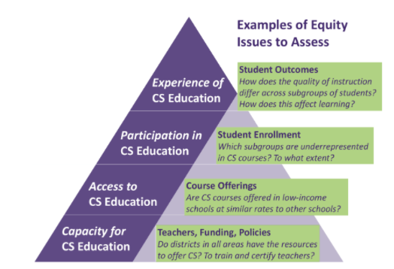
CSEd Success Metrics and CAPE Framework
ECEP CAPE Framework
Corresponding Success Metric
% of students taking AP Exam (StAP)
% of students in Foundational CS (StFCS)
% of student in HS with FCS (StHSCS)
% of HS with FCS (HSCS)

Slide 4
Report SUCCESS METRICS

Slide 5
SUCCESS METRIC Summary
 | % of HS with FCS (HSCS) | % Students in HS w/ FCS (StHSCS) | % Students Enrolled in FCS (StFCS) | % Students Taking AP Exam (StAP)
State Avg | 57.4% | 77.6% | 4.9% | 0.9%
State Std Dev | 17.7% | 11.9% | 3.3% | 0.9%
National Avg | 51.3% | 77.7% | 4.7% | 1.1%
States w/Data | 51 | 51 | 36 | 51
State Avg is average where each state has equal weight
National Avg is average weighted by number of schools or number of students
State of CSEd report focuses on # of policies implemented but not included in this study
AP Exams include both AP CS A and AP CS Principles

Slide 6
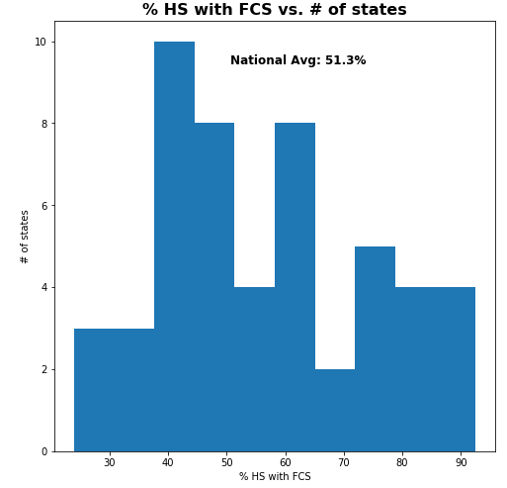
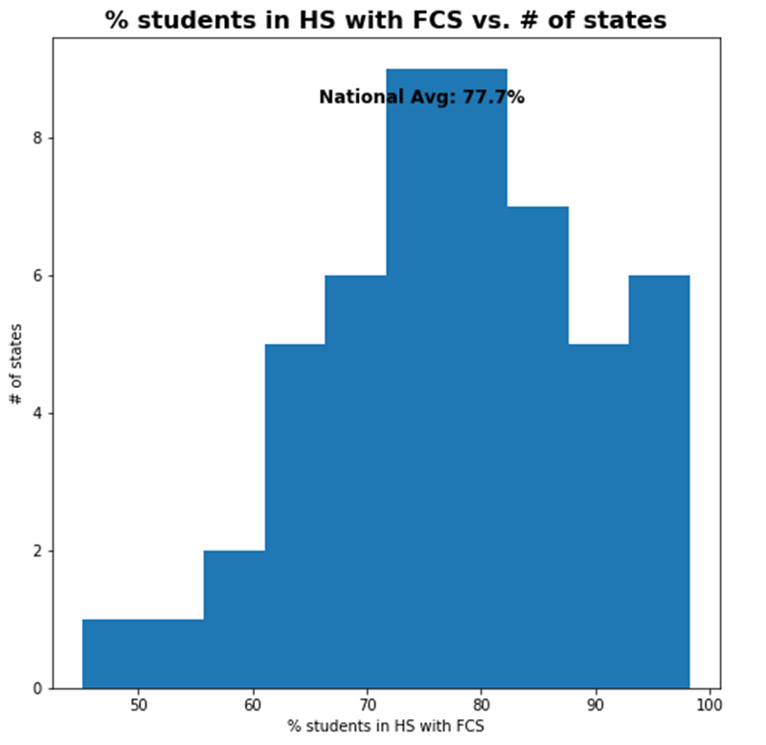
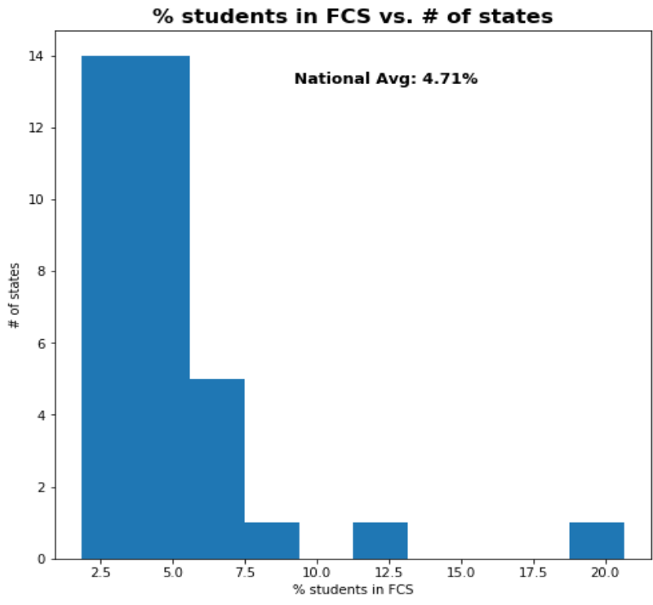
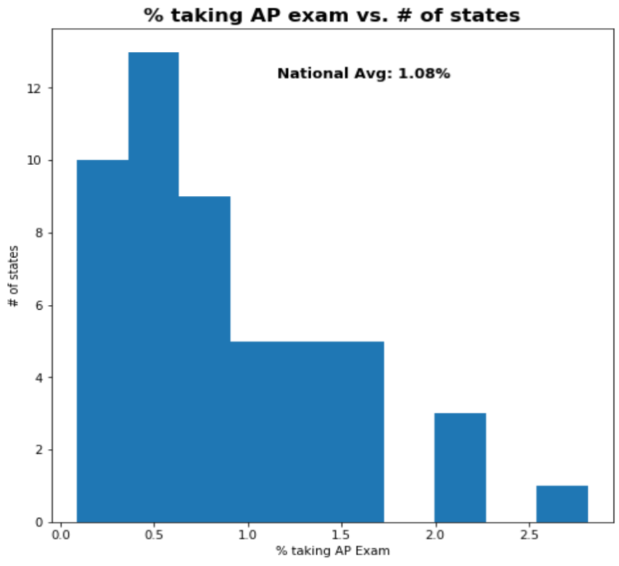
SUCCESS Metric HISTOGRAMs
% of HS with FCS
% Students in HS w/ FCS
% Students Enrolled in FCS
% Students Taking AP CS Exam

Slide 7
SUCCESS METRICS TOP States
% of HS with FCS
Arkansas 92.5% (1.98)
South Carolina 92.2% (1.96)
Maryland 90.1% (1.84)
% Students in HS w/ FCS
South Carolina 98.2% (1.74)
Arkansas 96.5% (1.59)
Maryland 96.1% (1.56)
% Students Enrolled in FCS
South Carolina 20.7% (4.67)
Maryland 12.5% (2.26)
Utah 9.35% (1.31)
% Students Taking AP Exam
Maryland 2.82% (3.26)
New Jersey 2.06% (1.98)
Connecticut 2.04% (1.95)
District of Columbia 2.04% (1.95)
() indicates Z-Score using avg/stdev of all states reporting

Slide 8
CAPE OPTIMIZATION Metrics

Slide 9
CAPE Optimization Metrics
StAP
StFCS
StHSCS
HSCS
AP/FCS Uptake Ratio (CP_StAP_StFCS)
What percentage of students taking an FCS course took an AP CS Exam?
FCS/School Uptake Ratio (CP_StFCS_StHSCS) What percentage of students in a school with FCS took an FCS course?
FCS School Size Ratio (CP_StHSCS_HSCS)
How does size of schools with FCS compare to average school size?
AP/School Uptake Ratio (CP_StAP_StHSCS)
What percentage of students in a school with FCS took an AP CS Exam?
Notes:
Because only 36 states provided StFCS data, CP_StFCS_StHSCS and CP_StAP_StFCS only exist for these states.

Slide 10
CAPE OptimiZation METRIC Summary
 | FCS School Size Ratio (CP_StHSCS_HSCS) | FCS/School Uptake Ratio (CP_StFCS_StHSCS) | AP/FCS Uptake Ratio (CP_StAP_StFCS) | AP/School Uptake Ratio (CP_StAP_StHSCS)
State Avg | 143.8% | 6.00% | 20.5% | 1.11%
State Std Dev | 34.4% | 3.34% | 12.7% | 0.77%
National Avg | 151.5% | 5.92% | 22.4% | 1.39%
States w/Data | 51 | 36 | 36 | 51
State Avg is average where each state has equal weight
National Avg is average weighted by number of schools or number of students

Slide 11
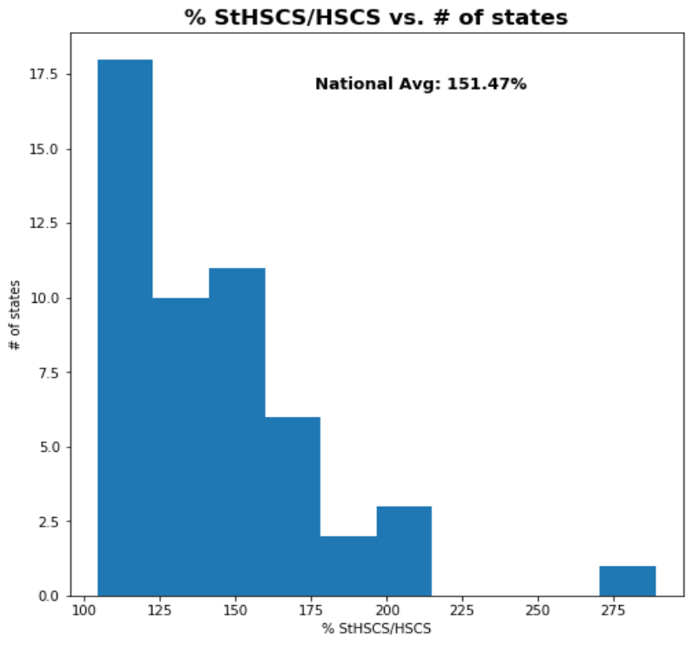
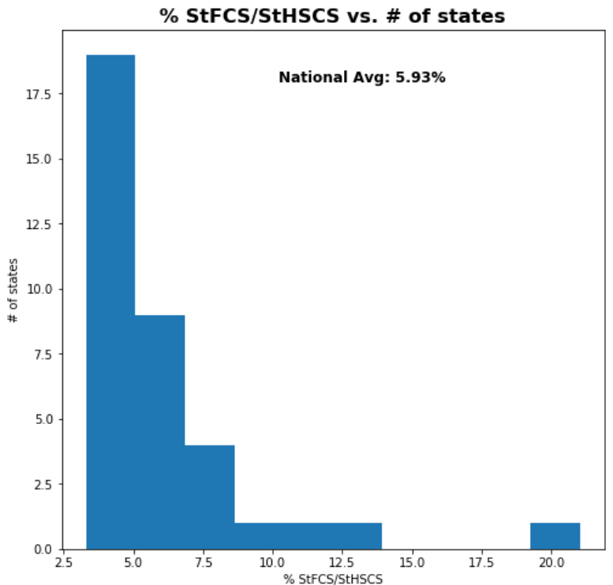
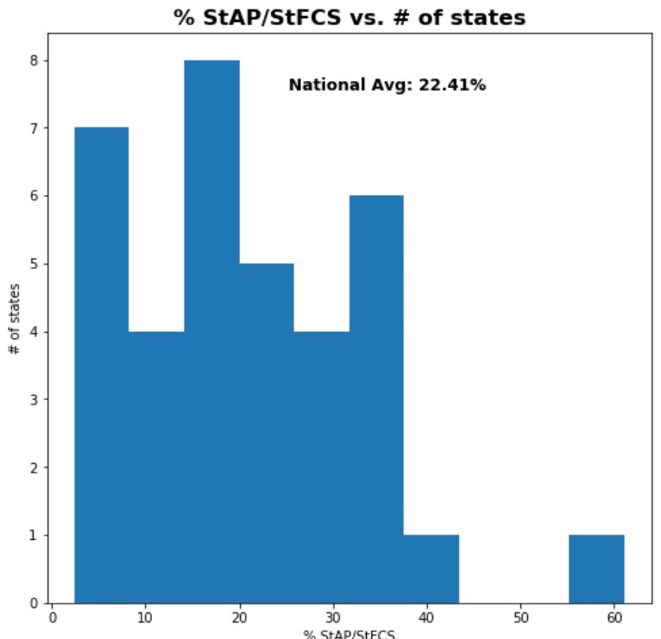
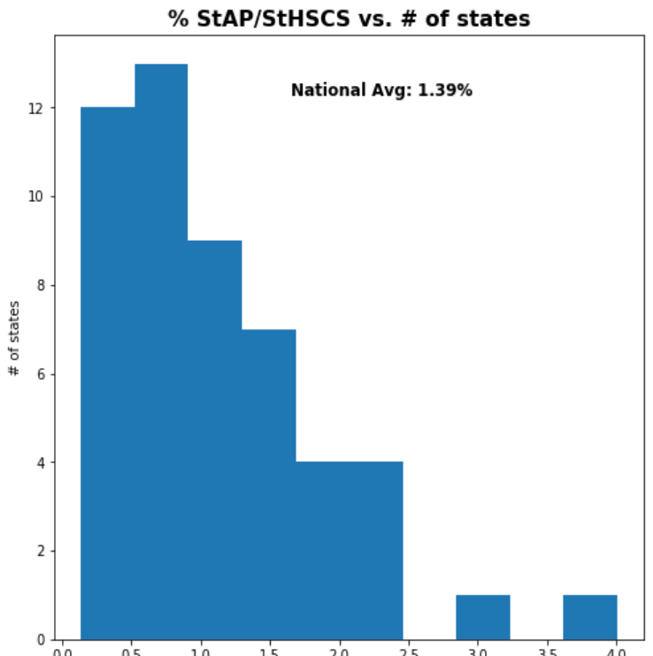
CAPE optimization Metric HISTOGRAMs
FCS School Size Ratio
(CP_StHSCS_HSCS)
FCS/School Uptake Ratio
(CP_StFCS_StHSCS)
AP/FCS Uptake Ratio
(CP_StAP_StFCS)
AP/School Uptake Ratio
(CP_StAP_StHSCS)

Slide 12
OPTIMIZATION METRICS TOP States
FCS School Size Ratio
Minnesota 288.9% (4.26)
Kansas 207.7% (1.88)
Arizona 205.3% (1.81)
FCS/School Uptake Ratio
South Carolina 21.0% (4.57)
Maryland 13.0% (2.14)
Utah 10.4% (1.35)
AP/FCS Uptake Ratio
Florida 61.1% (3.24)
Connecticut 38.5% (1.43)
Georgia 37.5% (1.36)
AP/School Uptake Ratio
District of Columbia 4.01% (3.82)
Maryland 2.93% (2.39)
New Jersey 2.35% (1.63)
() indicates Z-Score using avg/stdev of all states reporting

Slide 13
Relative Strength metrics
Female/Male, Black/White, HLLL/White

Slide 14
Relative Strength OPTIMIZATION Metrics
Metric | Description
RS FCS School Size Ratio (RS_CP_StHSCS_HSCS) | Relatively how many more/less Group A students attend a HS with FCS compared to Group B?
RS FCS/School Uptake Ratio (RS_CP_StFCS_StHSCS) | Given that a student is at a HS with FCS, relatively how many more/less Group A students take an FCS class compared to Group B?
RS AP/FCS Uptake Ratio (RS_CP_StAP_StFCS) | Given that a student is taking an FCS course, relatively how many more/less Group A students are taking an AP CS exam compared to Group B
RS AP/School Uptake Ratio (RS_CP_StAP_StHSCS) | Given that a student is at a HS with FCS, relatively how many more/less Group A students are taking an AP CS exam compared to Group B?
Relative Strength Metric divides the optimization metric for Group A by the same metric for Group B
In future should report on relative strength of success metrics
Small states can greatly skew these metrics

Slide 15
Female/Male Relative Strength metrics
 | RS FCS School Size Ratio (RS_CP_StHSCS_HSCS) | RS FCS/School Uptake Ratio (RS_CP_StFCS_ StHSCS) | RS AP/FCS Uptake Ratio (RS_CP_StAP_StFCS) | RS AP/School Uptake Ratio (RS_CP_StAP_StHSCS)
State Avg | 100% | 42.9% | 109.9% | 42.3%
State Std Dev | 0.0 | 17.3% | 24.3% | 12.6%
National Avg | 100% | 47.3% | 98.4% | 46.1%
States w/Data | 0 | 36 | 36 | 51
CSEd report does not contain female/male breakdowns for total students or student in HS with FCS. This report assumes that all states have 51/49 male/female division for both total students and students in HS with FCS

Slide 16
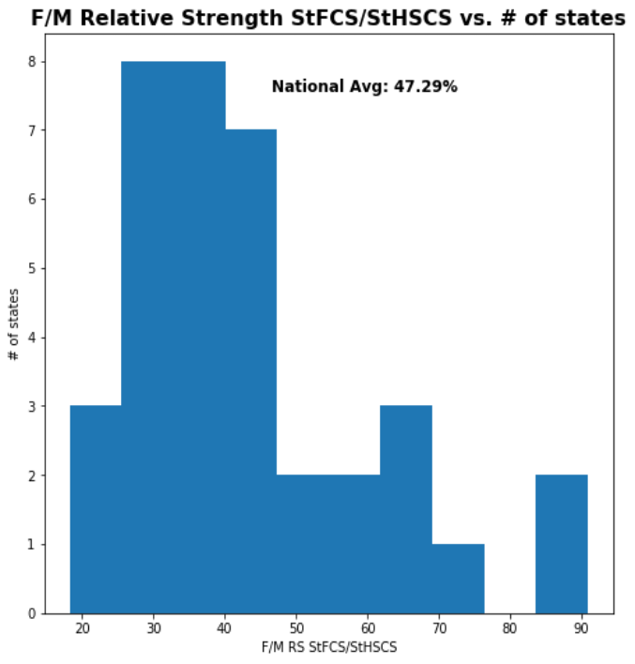
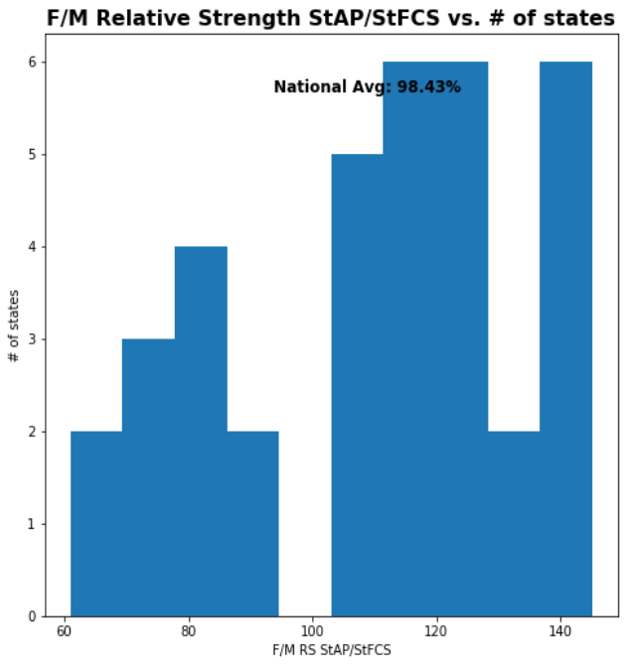
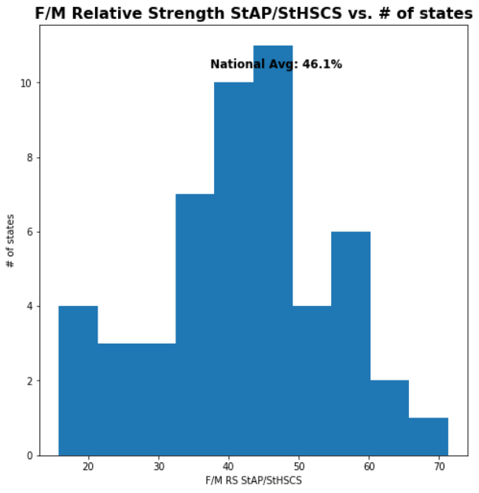
Female/Male RS metrics Histograms
N/A Assumed to be 1.0 for all states
RS FCS School Size Ratio
(RS_CP_StHSCS_HSCS)
RS FCS/School Uptake Ratio
(RS_CP_StFCS_StHSCS)
RS AP/FCS Uptake Ratio
(RS_CP_StAP_StFCS)
RS AP/School Uptake Ratio
(RS_CP_StAP_StHSCS)

Slide 17
Female/Male Relative Strength TOP States
F/M RS FCS/School Uptake Ratio
Mississippi 90.9% (2.81)
South Carolina 88.1% (2.65)
Maryland 71.2% (1.66)
F/M RS AP/FCS Uptake Ratio
Wyoming 145.0% (1.46)
Hawaii 145.0% (1.46)
Arizona 141.8% (1.33)
F/M RS AP/School Uptake Ratio
District of Columbia 71.3% (2.32)
Mississippi 63.5% (1.70)
Alabama 60.7% (1.47)
() indicates Z-Score using avg/stdev of all states reporting

Slide 18
BLACK/WHITE Relative Strength metrics
 | RS FCS School Size Ratio (RS_CP_StHSCS_HSCS) | RS FCS/School Uptake Ratio (RS_CP_StFCS_ StHSCS) | RS AP/FCS Uptake Ratio (RS_CP_StAP_StFCS) | RS AP/School Uptake Ratio (RS_CP_StAP_StHSCS)
State Avg | 98.8% | 91.8% | 63.5% | 45.5%
State Std Dev | 16.0% | 40.9% | 89.3% | 40.8%
National Avg | 92.7% | 106.2% | 44.6% | 46.8%
States w/Data | 0 | 35 | 35 | 51

Slide 19
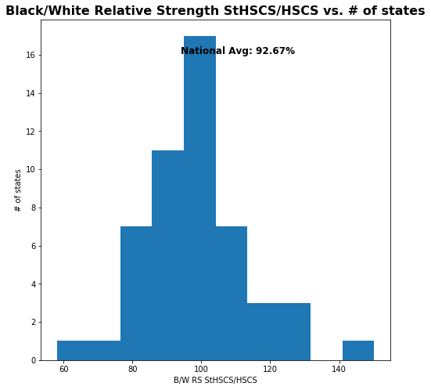
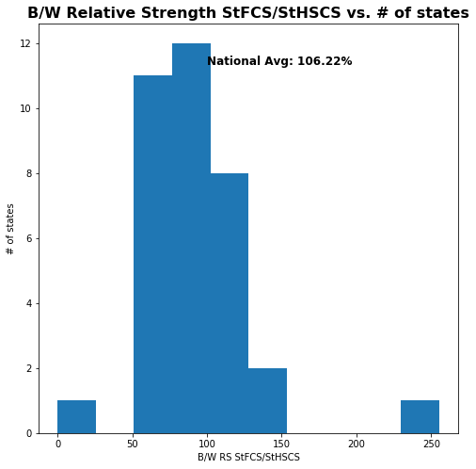
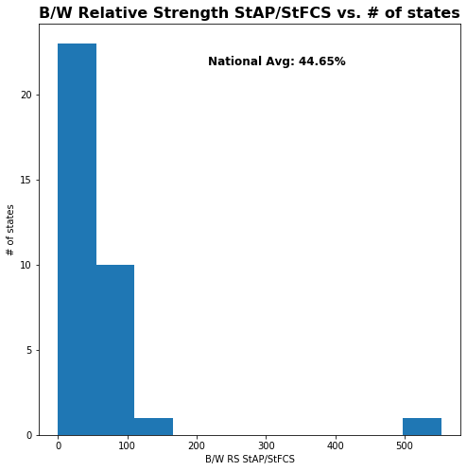
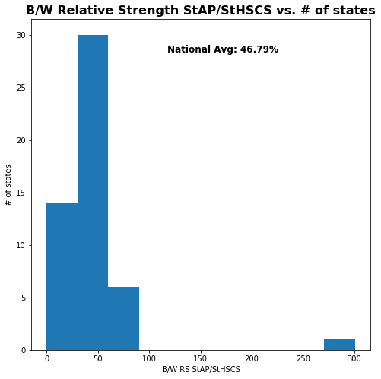
BLACK/WHITE RS metrics Histograms
RS FCS School Size Ratio
(RS_CP_StHSCS_HSCS)
RS FCS/School Uptake Ratio
(RS_CP_StFCS_StHSCS)
RS AP/FCS Uptake Ratio
(RS_CP_StAP_StFCS)
RS AP/School Uptake Ratio
(RS_CP_StAP_StHSCS)

Slide 20
BLACK/WHITE Relative Strength TOP States
B/W RS FCS School Size Ratio
Kansas 150.2% (3.25)
South Dakota 130.6% (2.01)
Nebraska 129.9% (1.97)
B/W RS FCS/School Uptake Ratio
Illinois 255.5% (4.06)
Louisiana 149.9% (1.44)
New York 139.3% (1.18)
B/W RS AP/FCS Uptake Ratio
Idaho 553.2% (5.56)
Iowa 125.8% (0.71)
Arizona 101.8% (0.43)
B/W RS AP/School Uptake Ratio
Montana 300.9% (6.32)
Utah 86.1% (1.00)
New York 82.7% (0.92)
() indicates Z-Score using avg/stdev of all states reporting

Slide 21
Hispanic-Latinx/WHITE Relative Strength metrics
 | RS FCS School Size Ratio (RS_CP_StHSCS_HSCS) | RS FCS/School Uptake Ratio (RS_CP_StFCS_ StHSCS) | RS AP/FCS Uptake Ratio (RS_CP_StAP_StFCS) | RS AP/School Uptake Ratio (RS_CP_StAP_StHSCS)
State Avg | 99.4% | 89.5% | 76.3% | 78.4%
State Std Dev | 8.9% | 25.3% | 35.3% | 57.0%
National Avg | 96.0% | 79.2% | 88.2% | 70.4%
States w/Data | 0 | 35 | 35 | 51

Slide 22
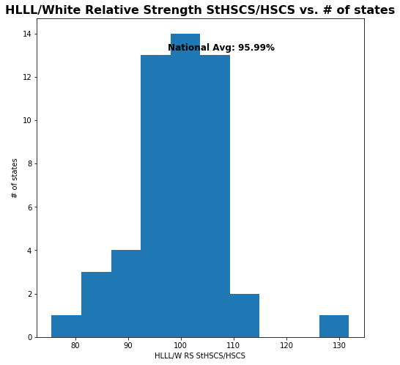
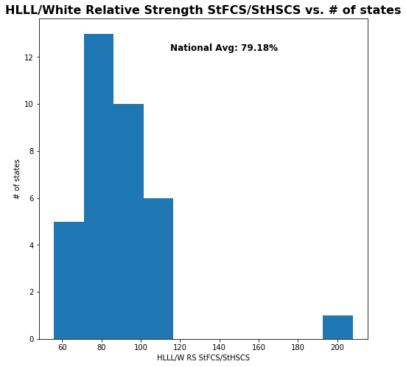
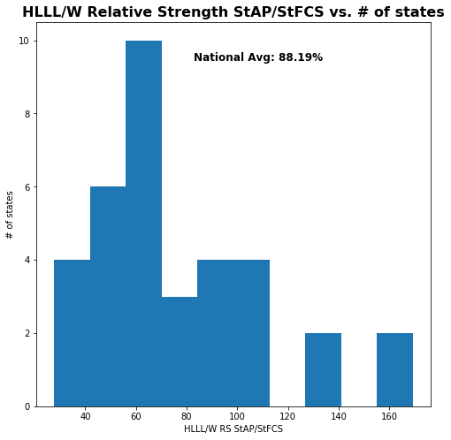
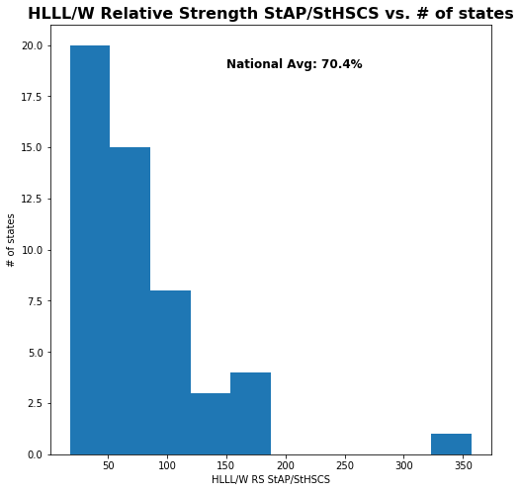
Hispanic-Latinx/White RS metrics Histograms
RS FCS School Size Ratio
(RS_CP_StHSCS_HSCS)
RS FCS/School Uptake Ratio
(RS_CP_StFCS_StHSCS)
RS AP/FCS Uptake Ratio
(RS_CP_StAP_StFCS)
RS AP/School Uptake Ratio
(RS_CP_StAP_StHSCS)

Slide 23
HISPANIC-LATINX/WHITE Relative Strength TOP States
HL/W RS FCS School Size Ratio
Kansas 131.8% (3.67)
Nebraska 112.6% (1.50)
Illinois 109.6% (1.16)
HL/W RS FCS/School Uptake Ratio
Illinois 208.0% (4.74)
New York 113.9% (0.98)
Utah 112.9% (0.94)
HL/W RS AP/FCS Uptake Ratio
West Virginia 169.3% (2.67)
Hawaii 168.3% (2.64)
Iowa 130.4% (1.55)
HL/W RS AP/School Uptake Ratio
Montana 357.0% (4.94)
West Virginia 186.0% (1.91)
Maine 185.1% (1.89)
() indicates Z-Score using avg/stdev of all states reporting

Slide 24
Overall Observations
TBD/For Discussion

Slide 25
Links
Google Colab Notebooks
https://colab.research.google.com/drive/1mm5IGc2qBlawCukNfp6MEE9J3JSvpCX-?usp=sharing
Data Files
https://drive.google.com/file/d/1jCUBaWoe52GdzIwLaM7TcZ_SQll9JgIv/view?usp=sharing (CSV)
https://docs.google.com/spreadsheets/d/1MZpi5Nid-BfpQ833Uy9rYgrvD8H3Yads/edit?usp=sharing&ouid=112866292549895118363&rtpof=true&sd=true (XLSX used to create CSV)
Original Data Sources
https://advocacy.code.org/2021_State_of_CS_data.xlsx (Numeric Data)
http://bit.ly/9policies (Policy data)

Slide 26
PLANNED NEXT Steps
More background data for gender/ethnic metrics (success metrics RS), outlier handling
Further Jupyter file cleanup and documentation
Public Github Checkin. Kaggle? Others?
Location/FRL Data Study
FCS/CS P/CS A Comparison Data Study

